Slide 1
Case study
Harry walker

Slide 2
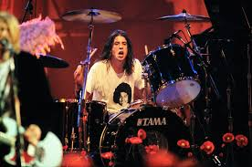
Dave ghrol
In 1986 at the age of 17 dave joined the punk rock band replacing drummer kent stax.
After scream broke up in 1990 grohl became the drummer of nirvana. He first appared on their second album nevermind.
After the death of kurt cobain nirvana disbanded and grohl formed foo fighters then realesed the first album (foo fighters)

Slide 3
Dave grohl continued
Grohl is also co founder of the rock supergroup them crooked vultures.
And then he recorded with queens of the stone age and tenacious D.
He also orginised a side project (late!)

